Slide 1
Lab 4
CS F213
Object Oriented Programming

Slide 2
Agenda
Loops
Nested Loops
Recursive Methods.
break and continue statements
Practice Problems to be done during lab hours.
Assignment Problems to be discussed for submission (on Jdoodle)
Extra Practice Problems
To be done outside lab hours

Slide 3
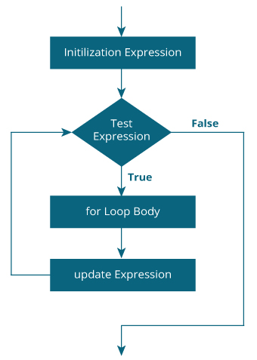
For Statement
for(initialization;condition;incr/decr){
//statement or code to be executed
}

Slide 4
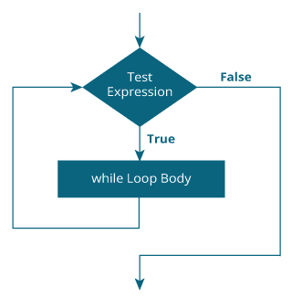
while statement
while(condition){
//code to be executed
}

Slide 5
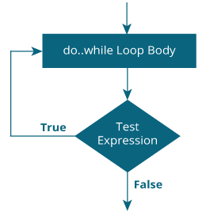
Do.. while statement
do{
//code to be executed
}while(condition);

Slide 6
Recursion
Recursion is a process in which a method calls itself continuously. A method in java that calls itself is called recursive method.
It makes the code compact but complex to understand.
There are two main requirements of a recursive function:
A Stop Condition – the function returns a value when a certain condition is satisfied, without a further recursive call
The Recursive Call – the function calls itself with an input which is a step closer to the stop condition

Slide 7
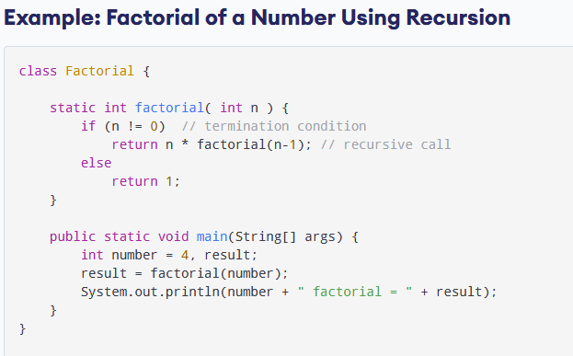

Slide 8
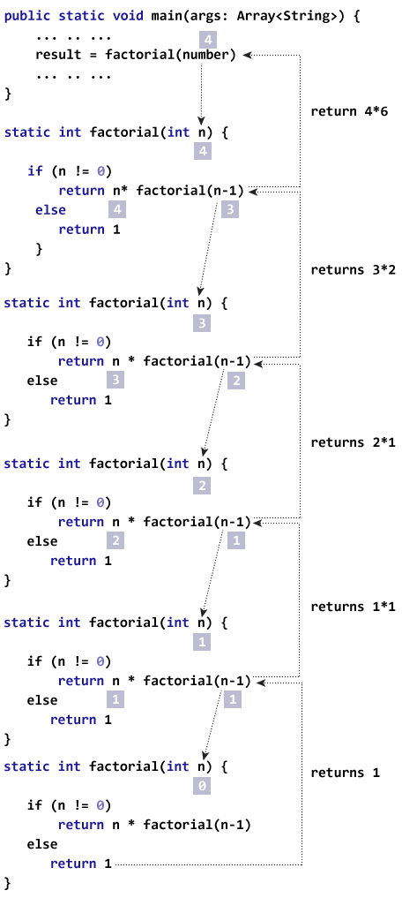
Flow of returning function values in Recursion

Slide 9
Recursion Versus Iteration
Recursion and Iteration both repeatedly execute the set of instructions.
Recursion is when a statement in a function calls itself repeatedly.
The iteration is when a loop repeatedly executes until the controlling condition becomes false.
The primary difference between recursion and iteration is that recursion is a process, always applied to a function and iteration is applied to the set of instructions which we want to get repeatedly executed.

Slide 10
Recursion
Recursion uses selection structure.
Infinite recursion occurs if the recursion step does not reduce the problem in a manner that converges on some condition (base case) and Infinite recursion can crash the system.
Recursion terminates when a base case is recognized.
Recursion is usually slower than iteration due to the overhead of maintaining the stack.
Recursion uses more memory than iteration.
Recursion makes the code smaller.

Slide 11
Iteration
Iteration uses repetition structure.
An infinite loop occurs with iteration if the loop condition test never becomes false and Infinite looping uses CPU cycles repeatedly.
An iteration terminates when the loop condition fails.
An iteration does not use the stack so it's faster than recursion.
Iteration consumes less memory.
Iteration makes the code longer.

Slide 12
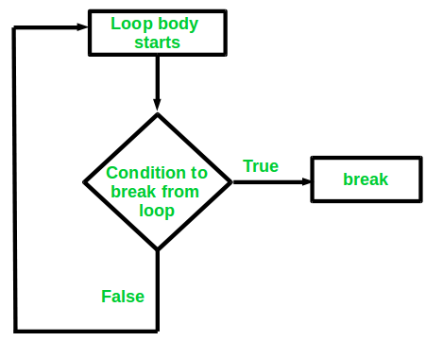
break statement
It is used to break loop or switch statement.
When a break statement is encountered inside a loop, the loop is immediately terminated and the program control resumes at the next statement following the loop.
break statement can be used in all types of loops such as for loop, while loop and do-while loop.
In case of inner loop, it breaks only inner loop.
break statement can also be used to jump out of target block.

Slide 13
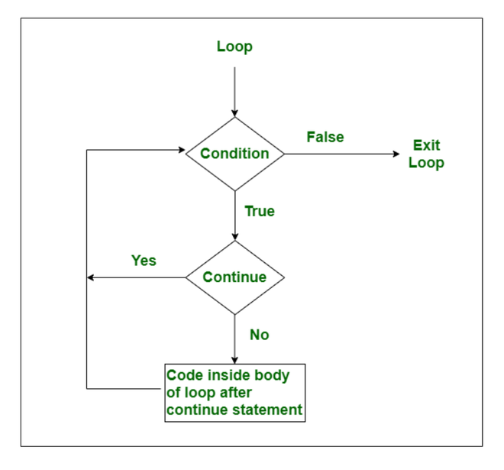
continue statement
The continue statement is generally used when we need to jump to the next iteration of the loop immediately.
It continues the current flow of the program and skips the remaining code at the specified condition.
It can be used in all types of loops such as for loop, while loop and do-while loop.
In case of an inner loop, it continues the inner loop only.
continue statement can be used with a label

